Slide 1

Struggling to Choose A Movie with a Friend or Family Member?

Slide 2
Movie Connect
by Kamdon Bird, Haiyang Liu

Slide 3
What is Movie Connect?
An application that is designed to redefine the way you experience movies. Gain access to movie suggestions tailored to your preferences and influenced by your friends and family. Innovative graph algorithms connect users, turning movie nights into interactive social events. The app encourages group engagement and shared viewing experiences. Effortlessly express your movie preferences with a simple swipe, making movie selection easy and fun.
Click button thumbs down if you didn't enjoy the movie and have no interest in watching it again
Click button thumbs up if you enjoyed the movie and would like to watch it again, or would like to see similar movies.
Click button details if you’d like to know more about the movie. Trailer, Producer, Actors, Etc.

Slide 4
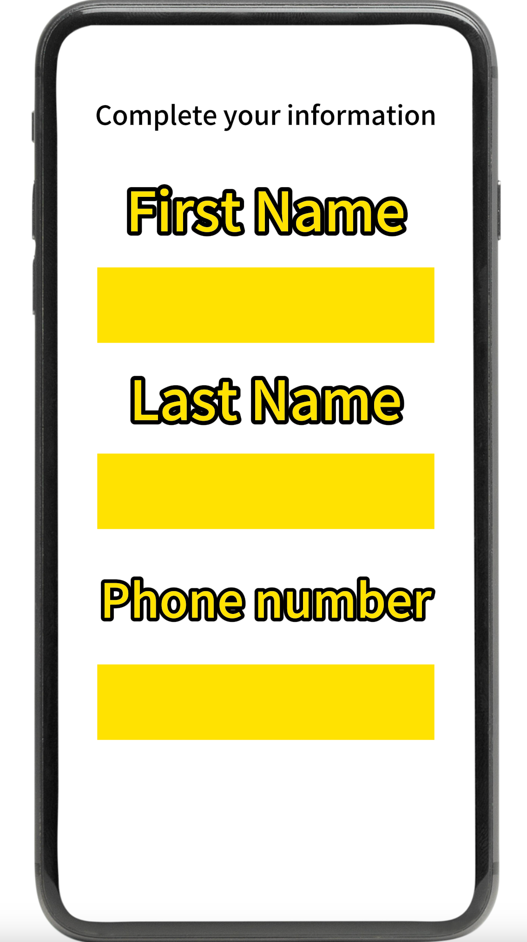
Start Page

Slide 5
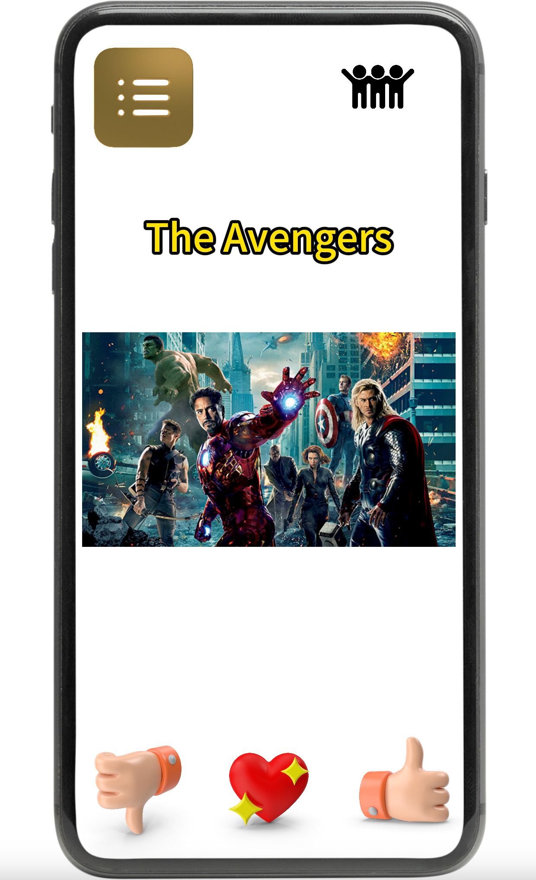
Main Page

Slide 6
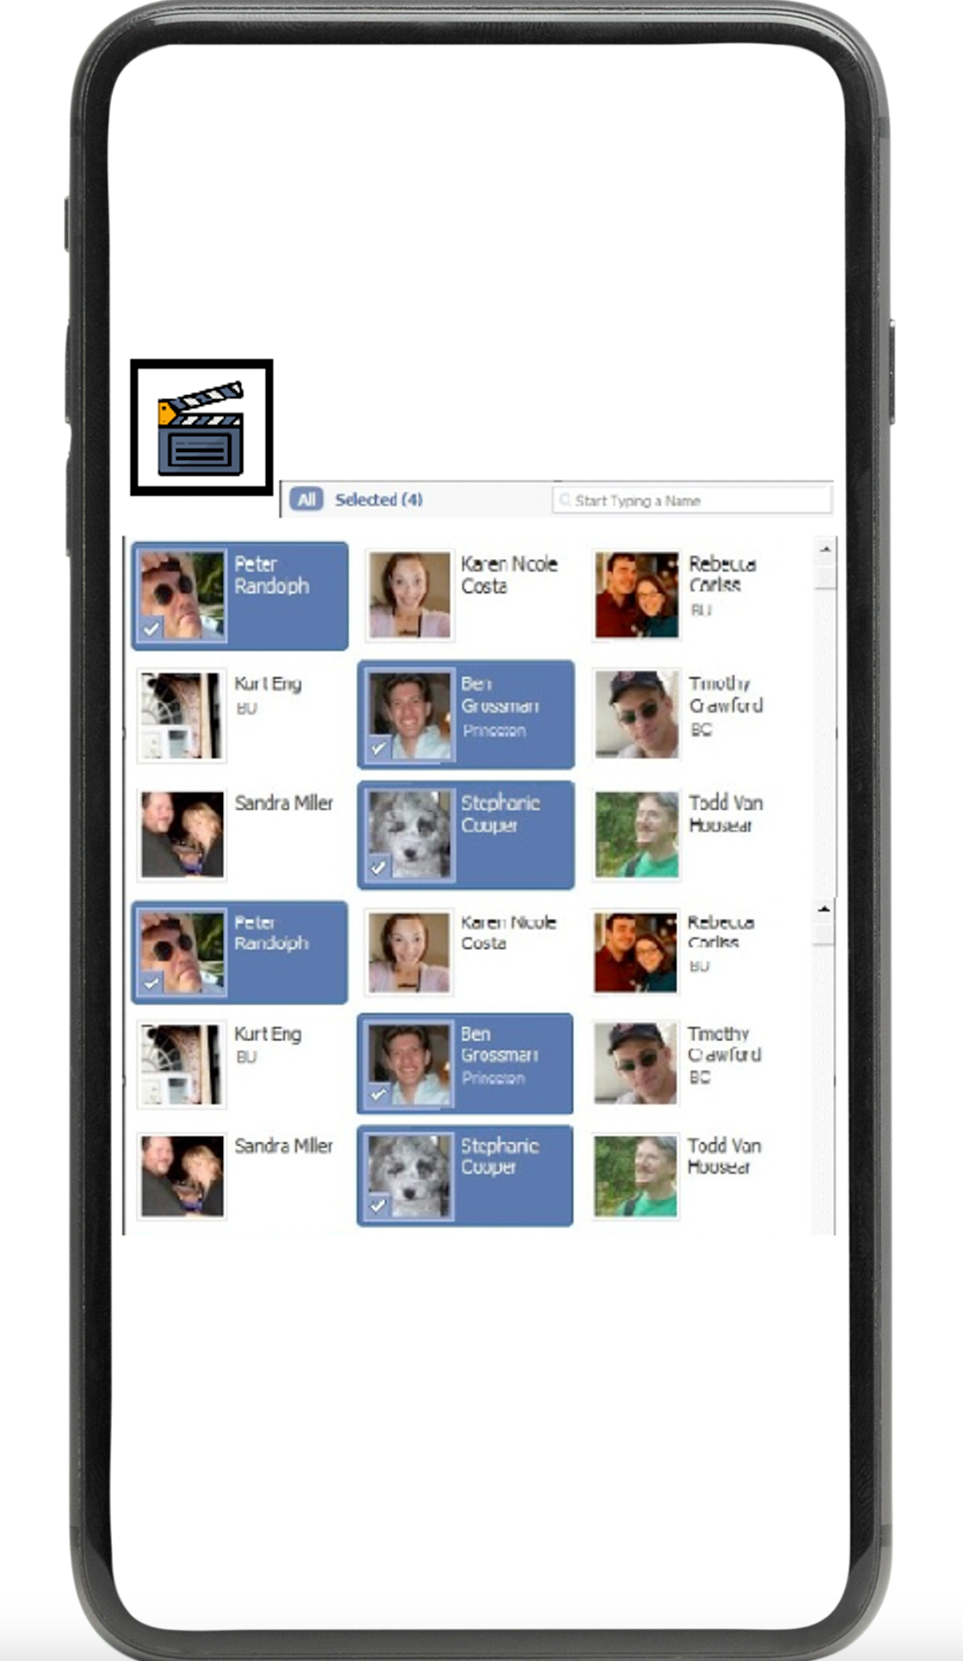
Friends Page (Select Person You’d like to Watch Movie With)

Slide 7
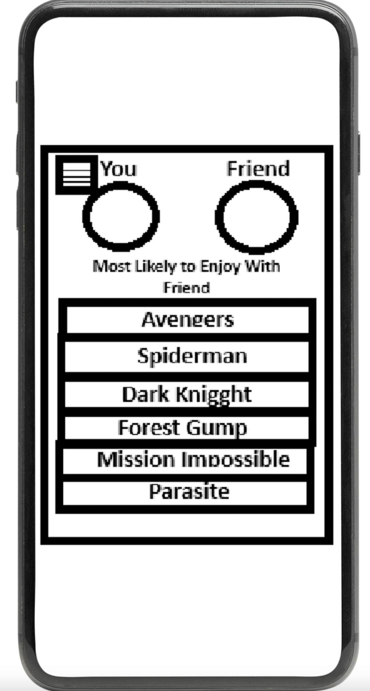
Movie Connect (Weighted Graph of Most Likely to Enjoy w/ Friend)

Slide 8
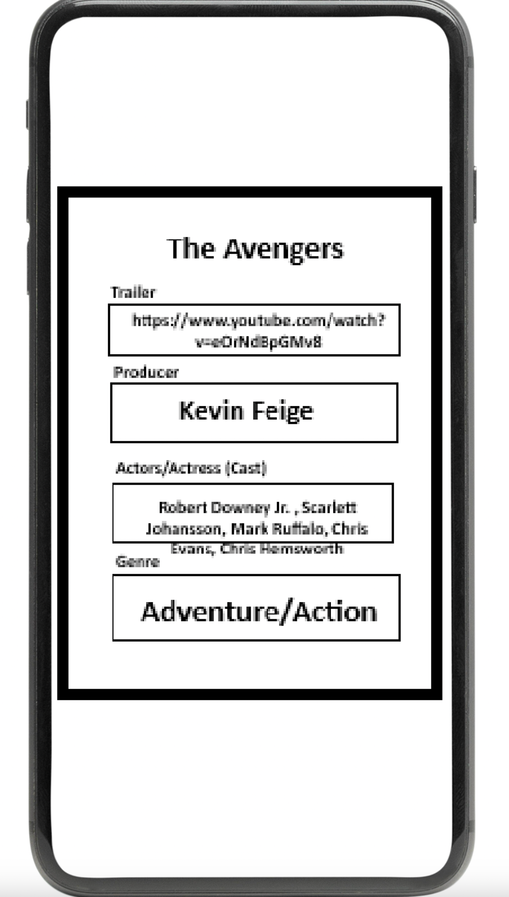
Details Page

Slide 9
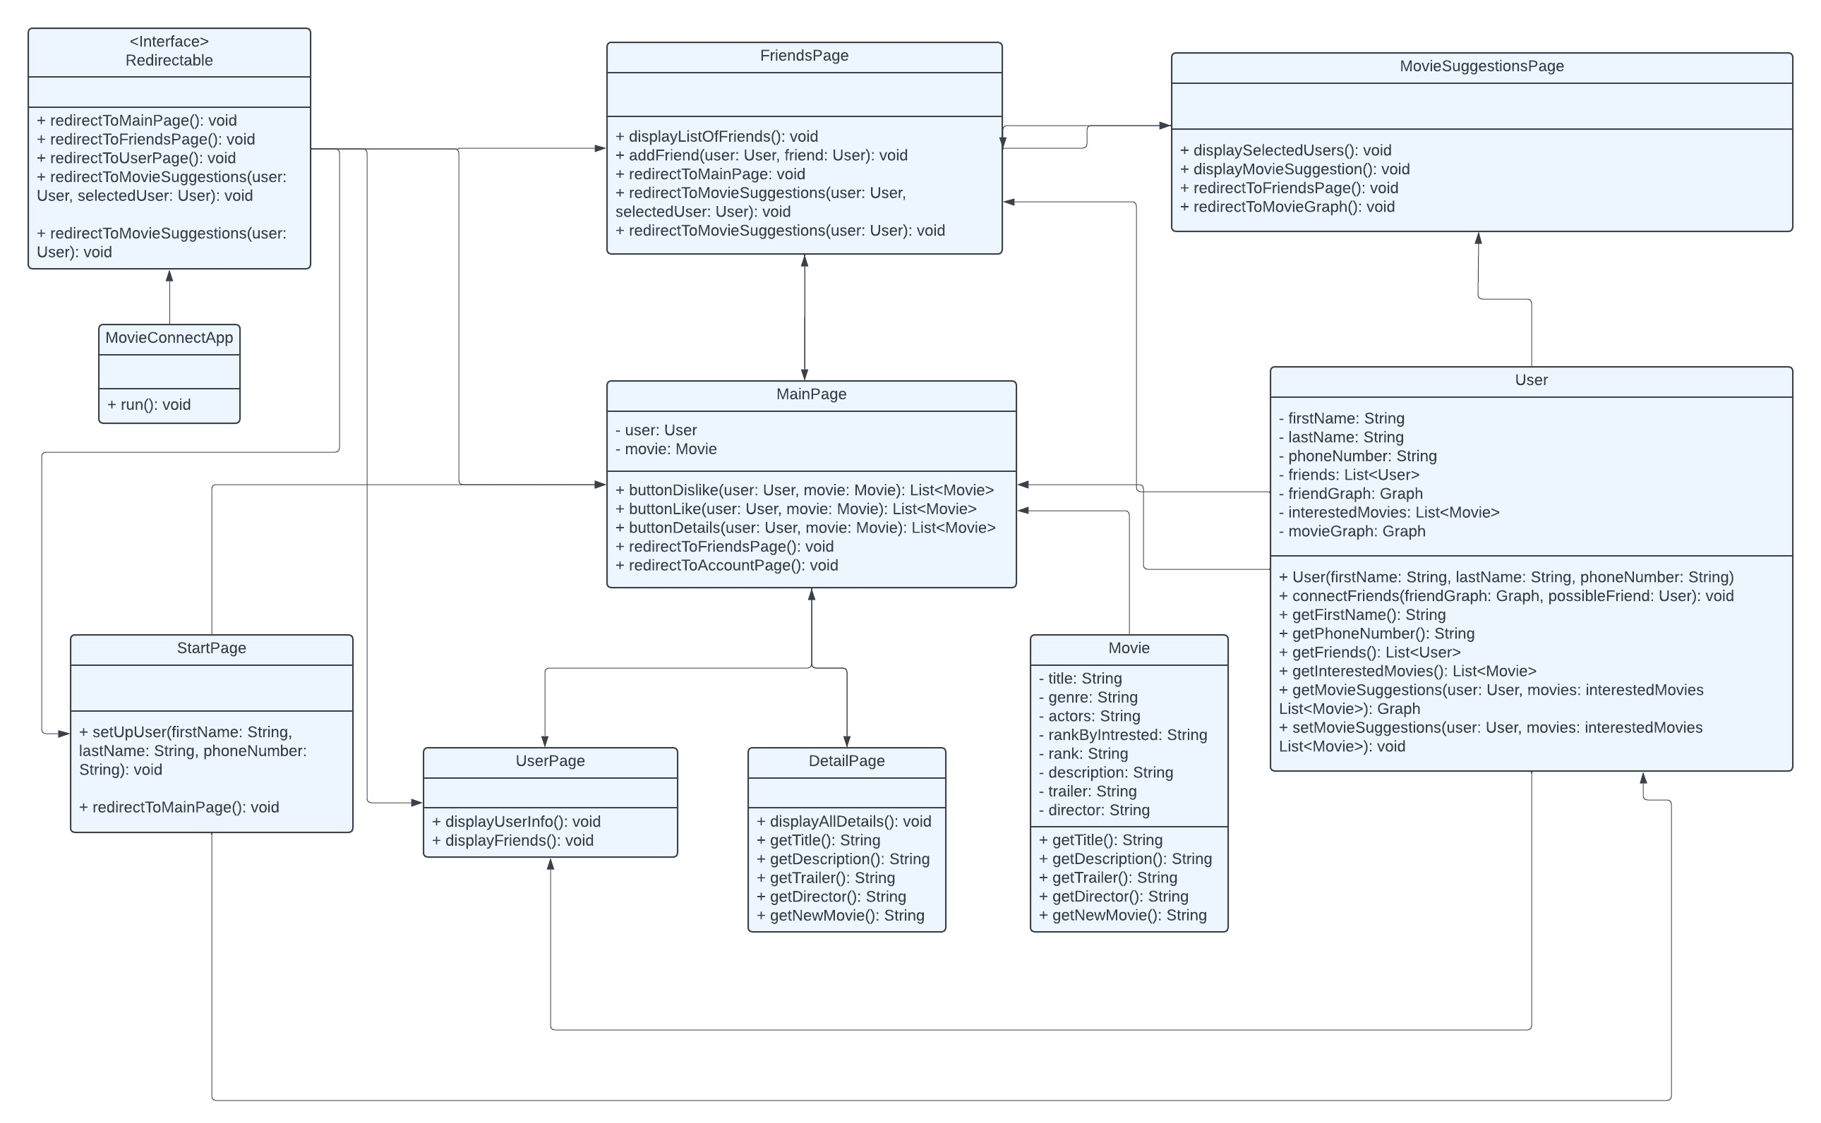
UML Diagram

